Slide 1
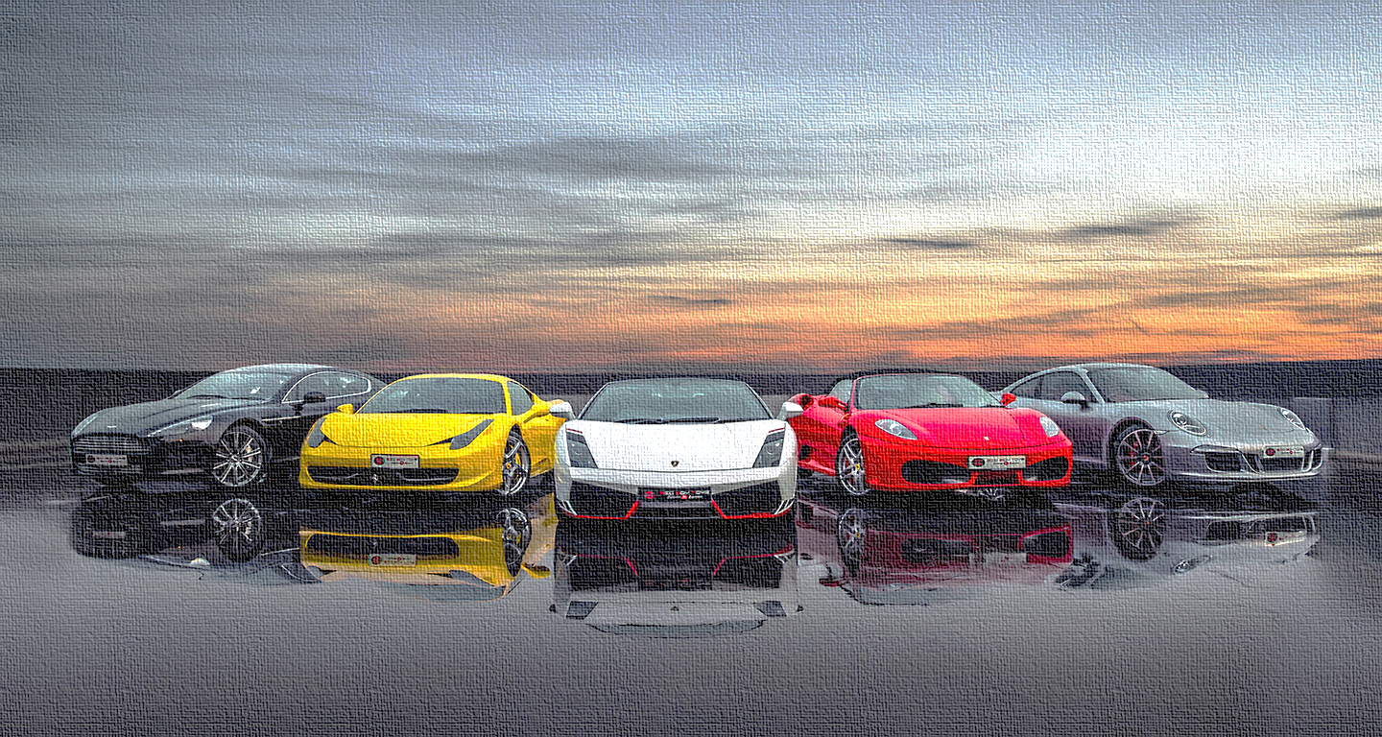
z
PRICE SUGGESTION FOR AUCTIONEXPORT.COM
TITTLE HERE
GROUP 09

Slide 2

QUESTION THAT WILL BE ANSWERED
AUCTION EXPORT.com is a web portal to the world of North American wholesale auto auctions.
Price ?
developing a model to provide a price suggestion for a vehicle that is going to be advertised.
a realistic price will attract more bids from the buyers.

Slide 3
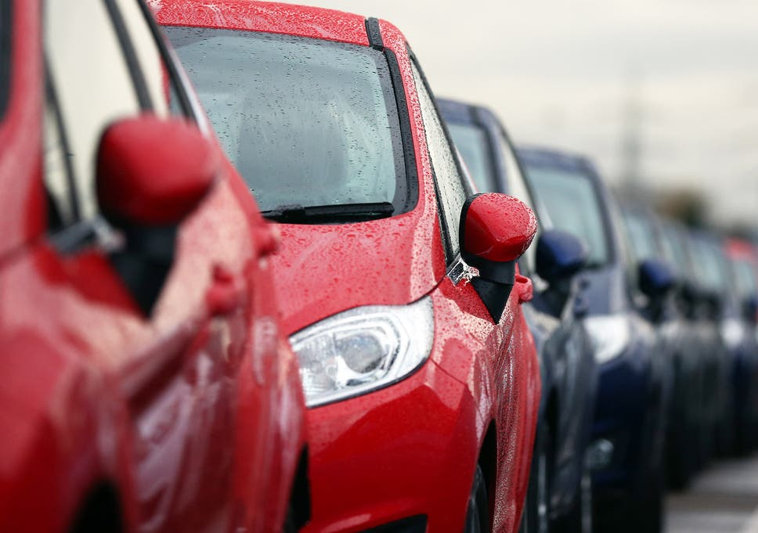
About the
Data Set…

Slide 4
Variable | Description
index | Index number of the vehicle
price | The sale price of the vehicle in the ad
years | The vehicle registration year
brand | The brand of car
model | Model of the vehicle
title_status | Clean Vehicle/Salvage Insurance
color | Color of the vehicle
Mileage | Miles travel by vehicle
Vin | The vehicle identification number
Lot | Identification number assigned to a particular lot
Condition | Time to the end of the auction from the snapshot date
State | The state in which the car is being available for purchase
Country | USA/Canada
13 variables & 2499 observations

Slide 5
FROM THE DESCRIPTIVE ANALYSIS…

Slide 6
No missing values
Price =0 : 43 cars- discarded
Country – USA & Canada
From the Descriptive Analysis

Slide 7

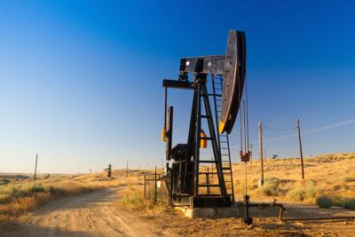

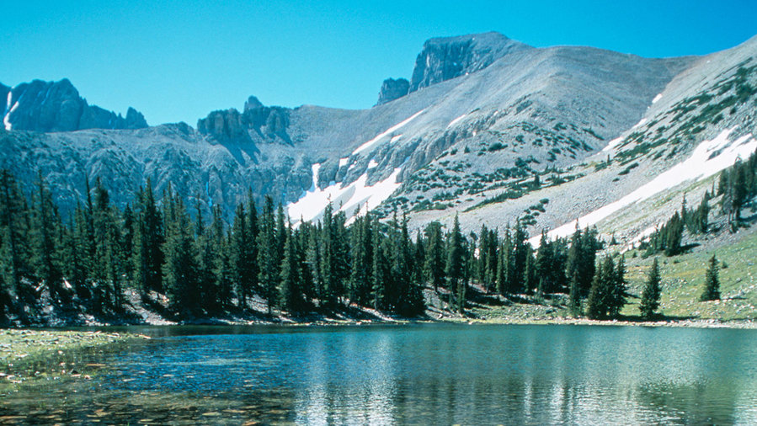
Nevada

Slide 8
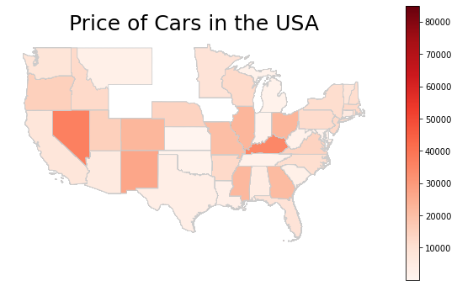
Most expensive cars: Nevada and Kentucky
From the Descriptive Analysis
Nevada
Kentucky

Slide 9
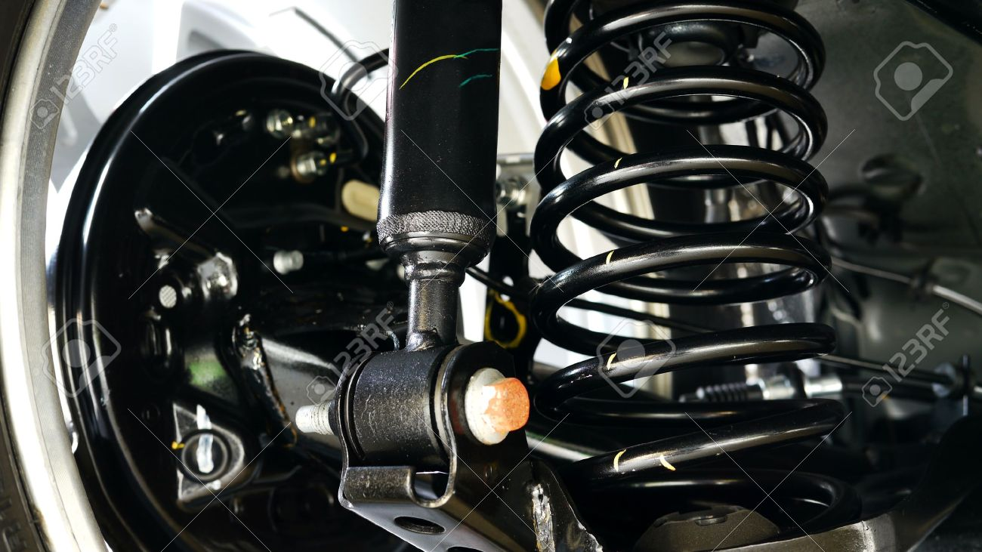
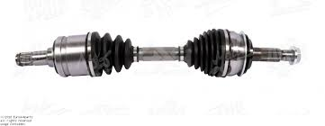
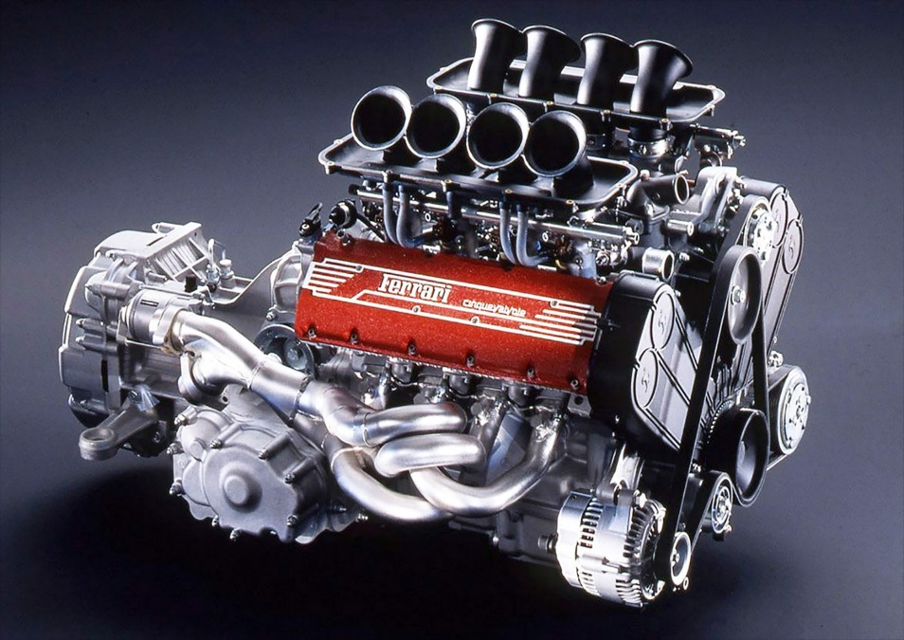
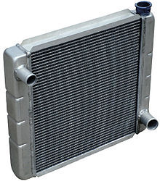
100K+ Mileage

Slide 10
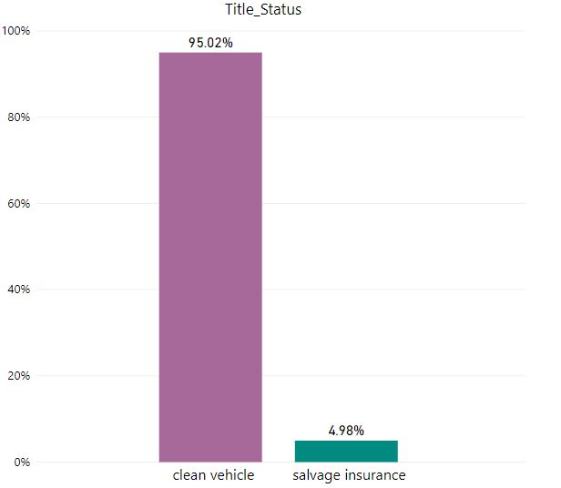
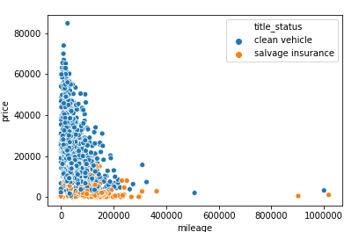
Price Vs Mileage by Title_Status

Slide 11
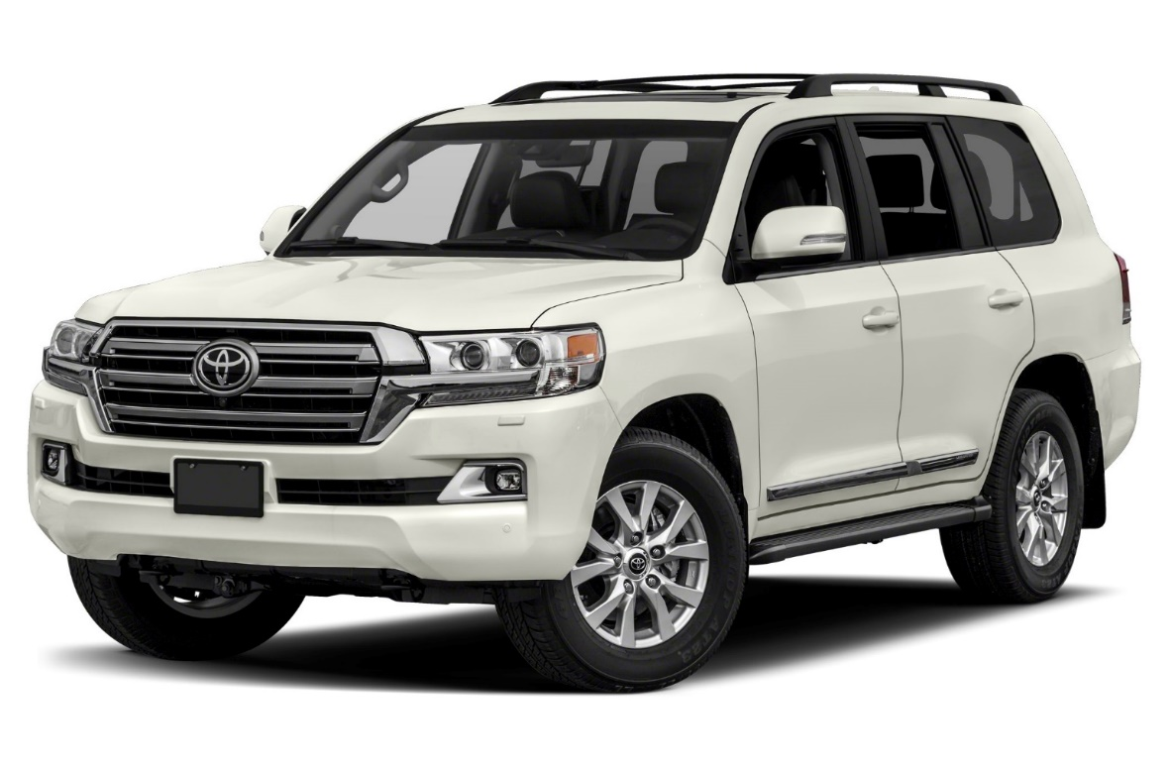
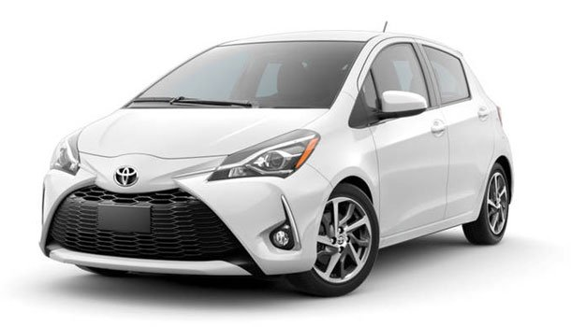
VS

Slide 12
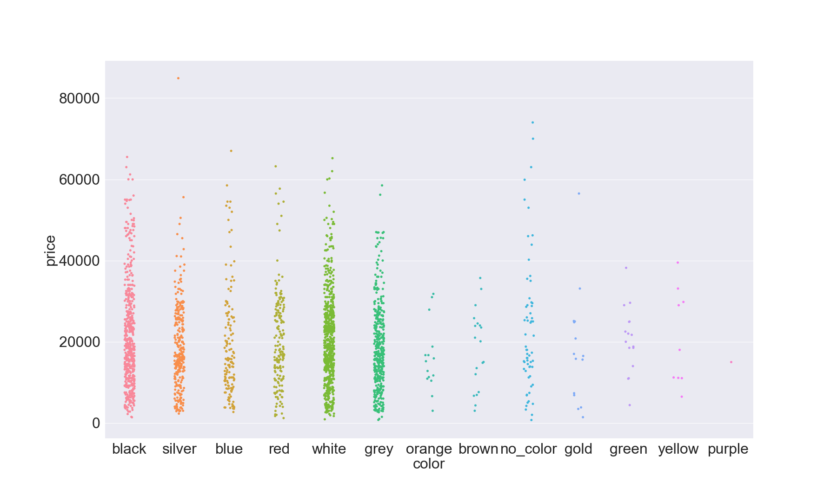
Most popular colors: Black, Silver, Blue, Red, White , Grey
From the Descriptive Analysis

Slide 13
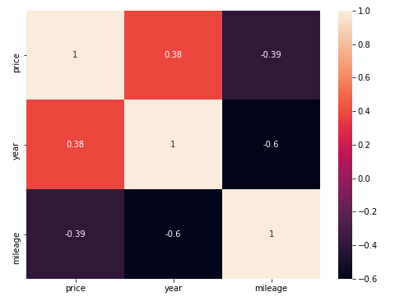
Continuous Predictor Variables seem to be correlated
From the Descriptive Analysis

Slide 14
Outline
Imbalance handling
Fitting Models
Split the data set by Title_status
Fit separate models for the 2 categories
Drop unnecessary variables
Try Fitting models to imbalance handled datasets
Compare the RMSE for balanced and imbalanced data sets
Calculate RMSE for the 2 models combined
Compare and select the best model
Train-test split

Slide 15
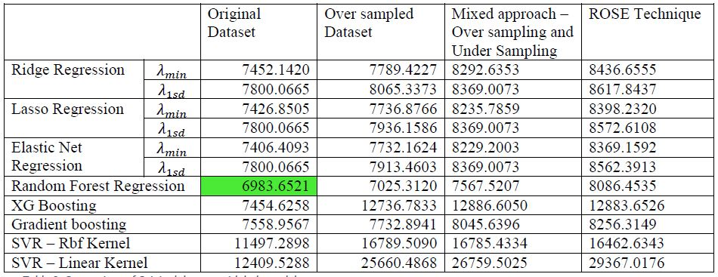
Original Data Vs Balanced Data

Slide 16
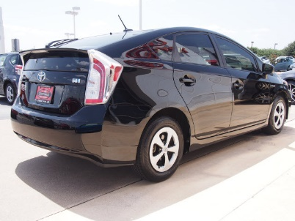
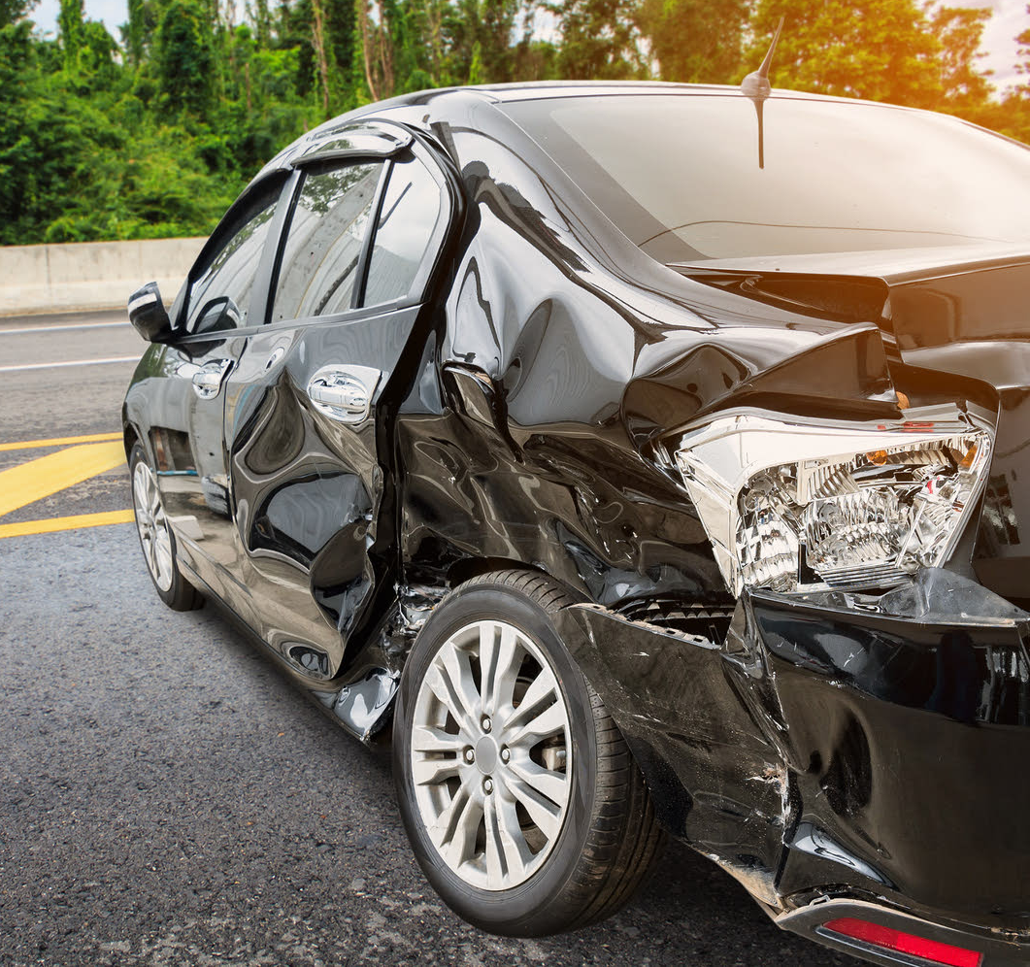
Splitting the data set by Title Status

Slide 17
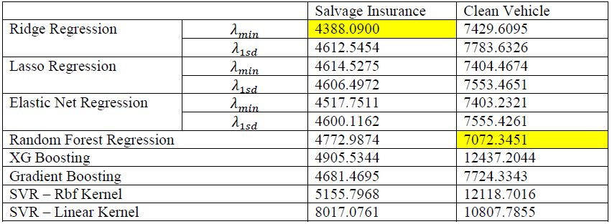
Salvage Vehicles and Clean Titled Vehicles

Slide 18

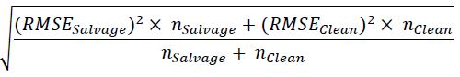
Best Model
Combined RMSE
Original RMSE
6983.6521
Frequently, your initial font choice is taken out of your awesome
6977.4643

Slide 19
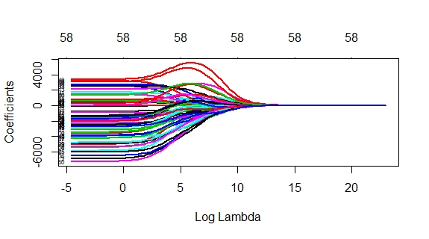
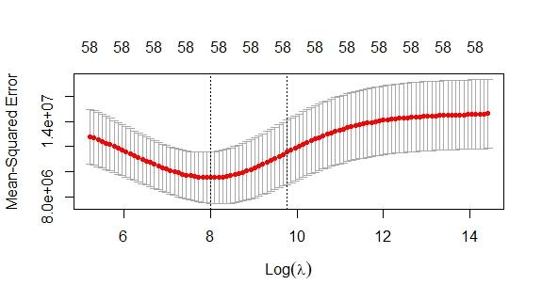
Ridge Regression : Salvage Insurance
Min log(lambda) =7.9698

Slide 20
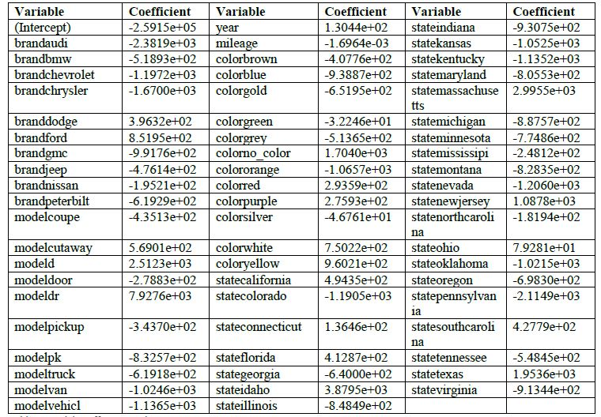
Model Coefficients for Salvage Insurance
Frequently, your initial font choice is taken out of your awesome

Slide 21
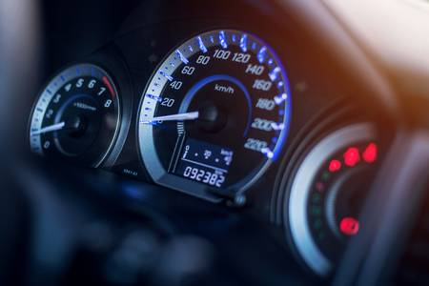

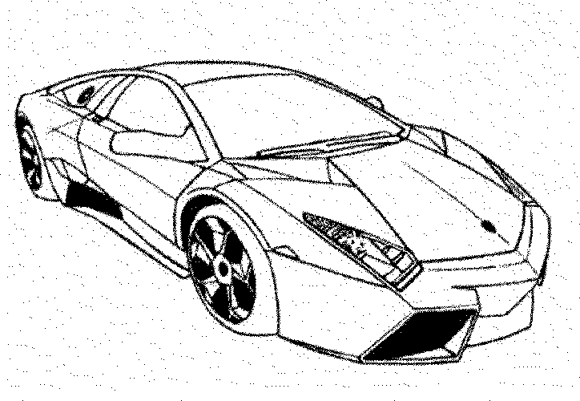

Model Interpretation
Mileage : -1.6964e-03
Year: 1.3044e+02
stateOhio : 7.9281e+01
ColorWhite : 7.5022e+02
ColorRed : 2.9359e+02
stateNevada : -1.2060e+03
noColor : 1.7040e+03
stateKentucky : -1.1352e+03

Slide 22
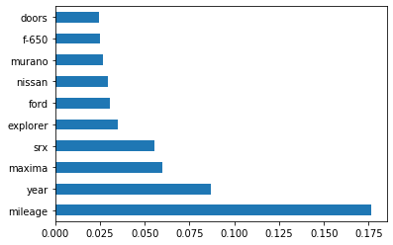
Random Forest Model For Clean Vehicles
Parameters | Best Value
n_estimators | 1600
min_samples_split | 5
min_samples_leaf | 1
max_depth | 70

Slide 23
Problems Faced
Imbalance in the predictor variable “Title_status”
High RMSE Values
High RMSE Values despite of separate models
Fit models separately to Clean titled and Salvage insurance vehicles
Imbalance handling techniques??
Deep learning
A
B
C

Slide 24

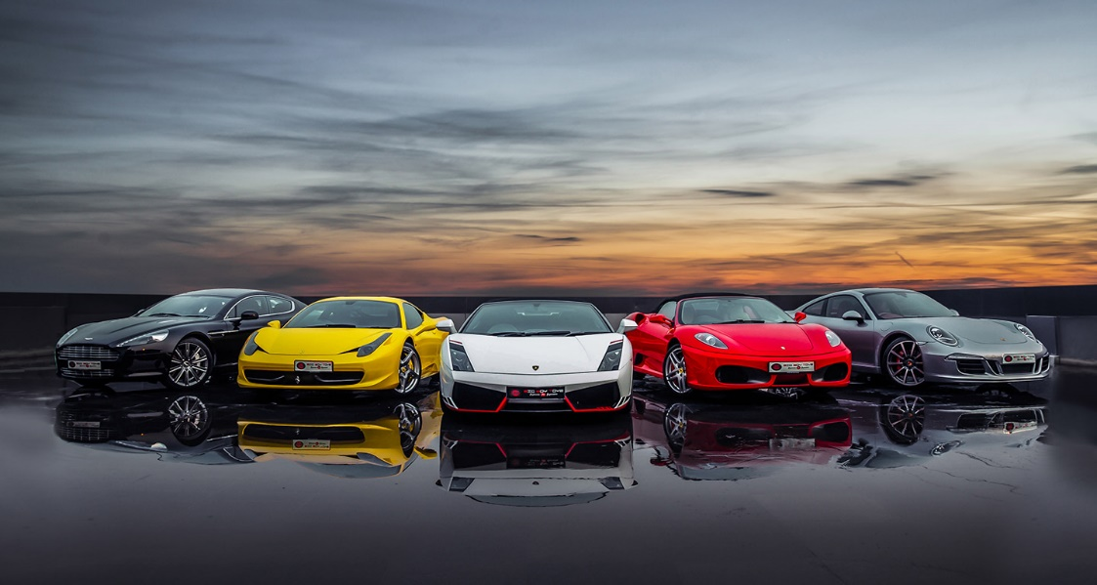
Data Product
A web application which gives an estimated price for a car being advertised in AUCTIONEXPORT.com

Slide 25

https://machinelearningmastery.com/implement-random-forest-scratch-python/
https://medium.com/pursuitnotes/support-vector-regression-in-6-steps-with-python-c4569acd062d
https://machinelearningmastery.com/gradient-boosting-machine-ensemble-in-python/
https://machinelearningmastery.com/develop-first-xgboost-model-python-scikit-learn
https://www.kaggle.com/sergiogaleano/predictive-modeling-u-s-cars-dataset
https://towardsdatascience.com/having-an-imbalanced-dataset-here-is-how-you-can-solve-it-1640568947eb
https://today.yougov.com/ratings/automotive/popularity/car-makers/all
https://coursera.org/share/622d4039cf8a716815c97cf260e48044
https://coursera.org/share/0090c444b022034d2e27ab58020a317c
http://www.edx.org/course/cs50s-web-programming-wth-python-and-javascript
https://blog.cambridgespark.com/deploying-a-machine-learning-model-to-the-web-725688b851c7
https://www.w3schools.com/
https://flask.palletsprojects.com/en/1.1.x/
Flask Web Development: Developing Web Applications with Python 2nd Edition – Miguel Ginberg
References

Slide 26
THANK YOU…
GROUP 09
Chamodi Perera S13566
Migara Devinda S13370
Sathsara Rasantha S13630

